Slide 1
E Bike
Why purchase our E-ST 500 V2?
Notes:
Welcome blabla

Slide 2
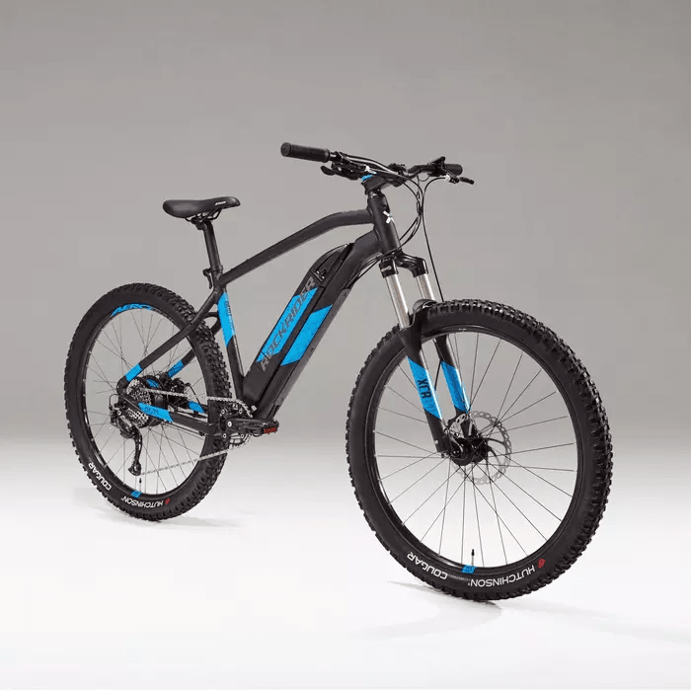
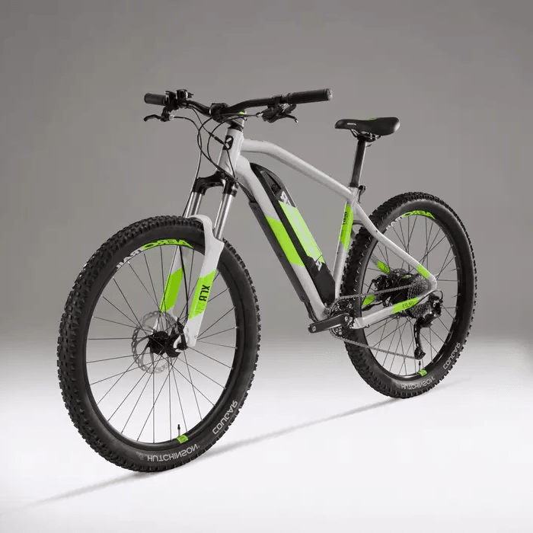
2 Colors
Black / Mediterranean Blue
Lunar Moon
Notes:
2 couleurs

Slide 3
4 Sizes availables
S
M
L
XL
Notes:
4 tailles

Slide 4

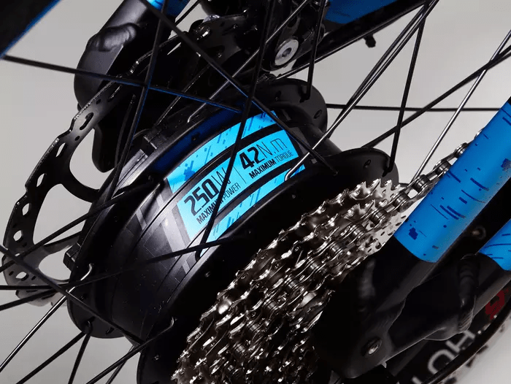
Motor
Power :
250W
Torque :
42Nm
Notes:
Moteur

Slide 5
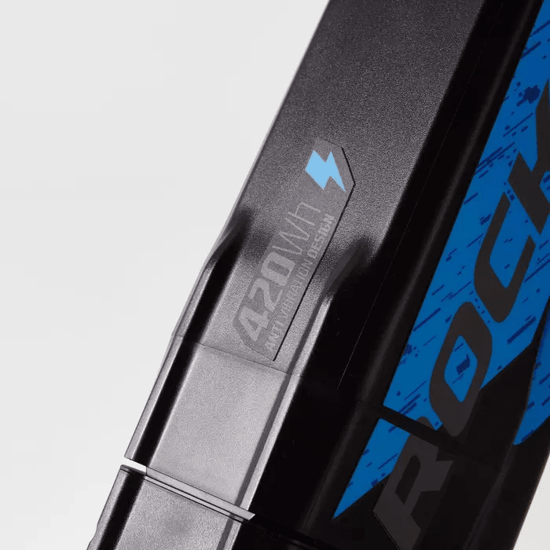
Battery - 420Wh - 36V - 11.6Ah - 2H30 autonomy
Notes:
Batterie

Slide 6
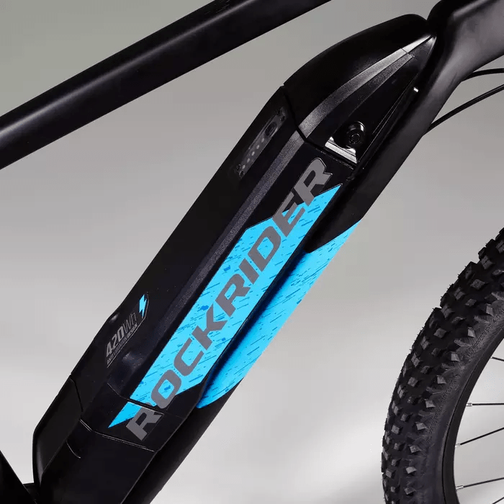
Charge indicator
Notes:
Indicateur de charge

Slide 7
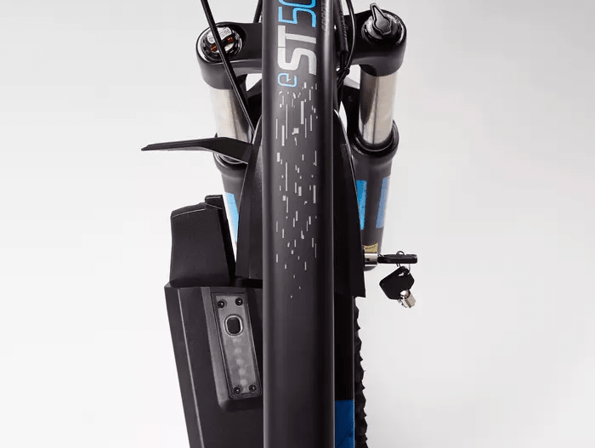
Lockable and Removable battery
Notes:
Batterie démontable

Slide 8
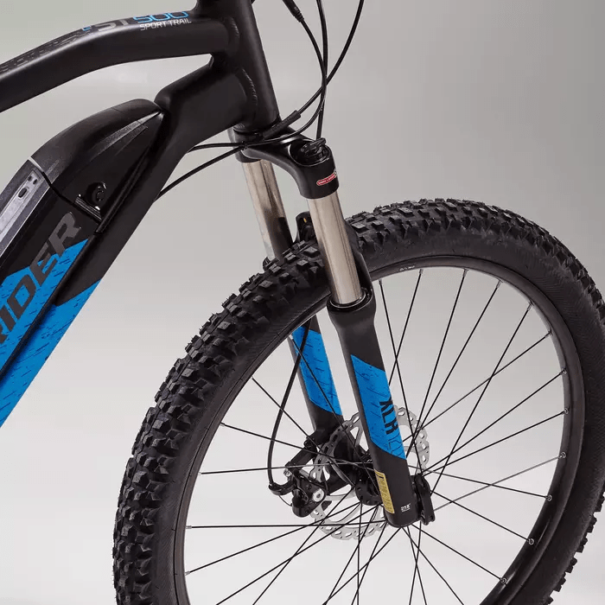
27.5’’ Tires
Notes:
Pneu

Slide 9
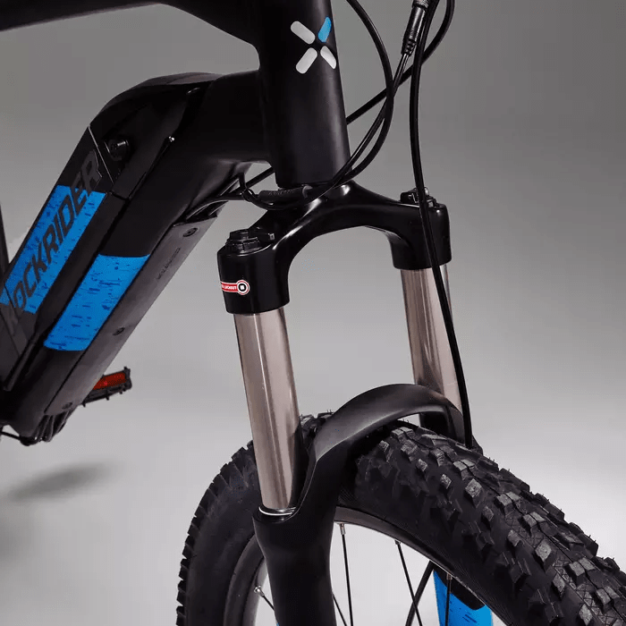
Front Suspension
Notes:
Suspension

Slide 10
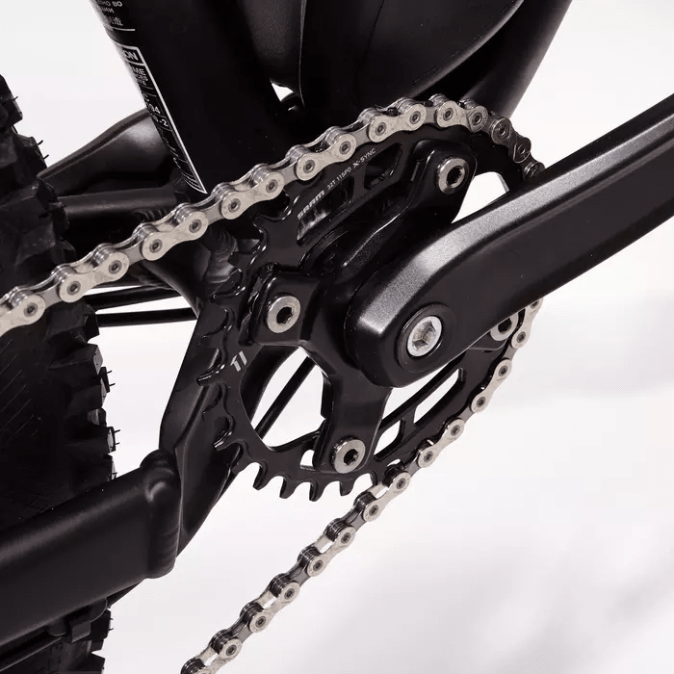
Torque sensor
Notes:
Couple

Slide 11
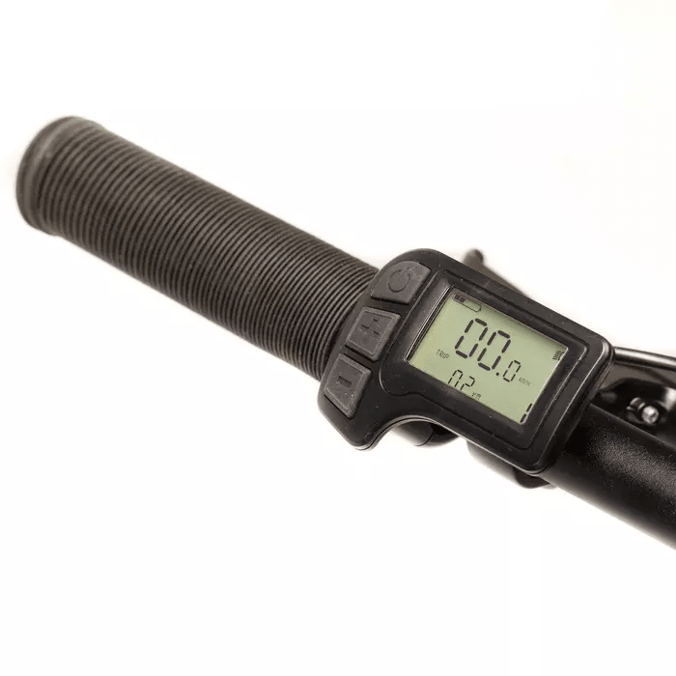
LCD Screen
Notes:
Ecran LCD

Slide 12
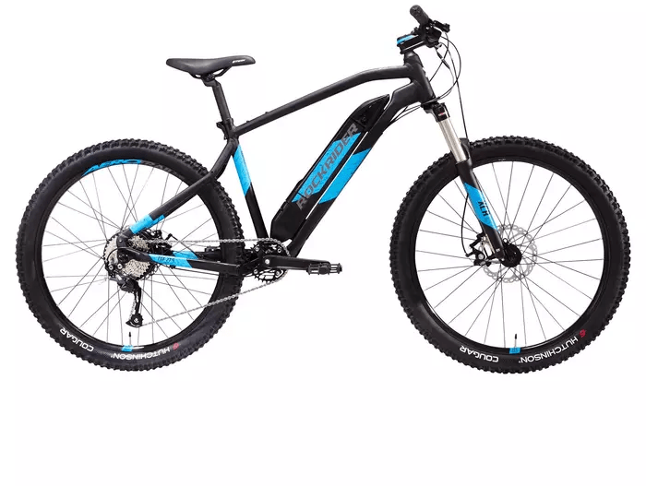
100% Aluminium Frame
Notes:
Cadre

Slide 13
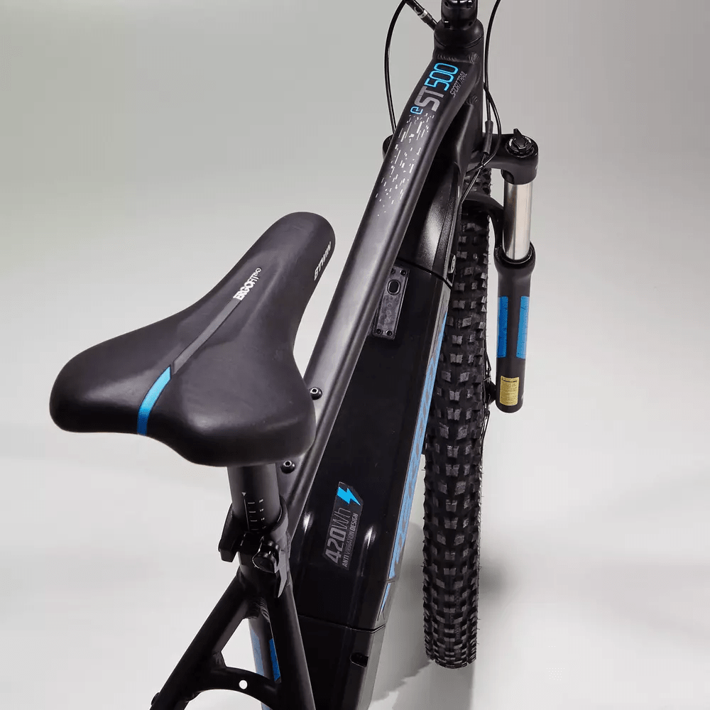
ERGONOMIC SADDLE
Notes:
Selle

Slide 14

Developed in France
Notes:
Made in France

Slide 15

We recycle your old bike
Up to 300€ on your old VTT
View conditions on occasions.decathlon.fr
Notes:
Recyclage

Slide 16
E-ST 500 V2 Black-Blue / Yellow 27,5"
1199€
AVAILABLE NOW AT
Decathlon.fr
Notes:
Apple

